Slide 1
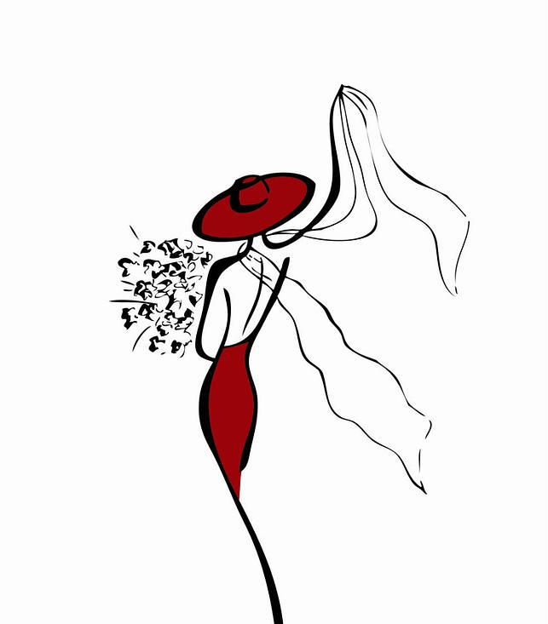
My Portfolio website

Slide 2
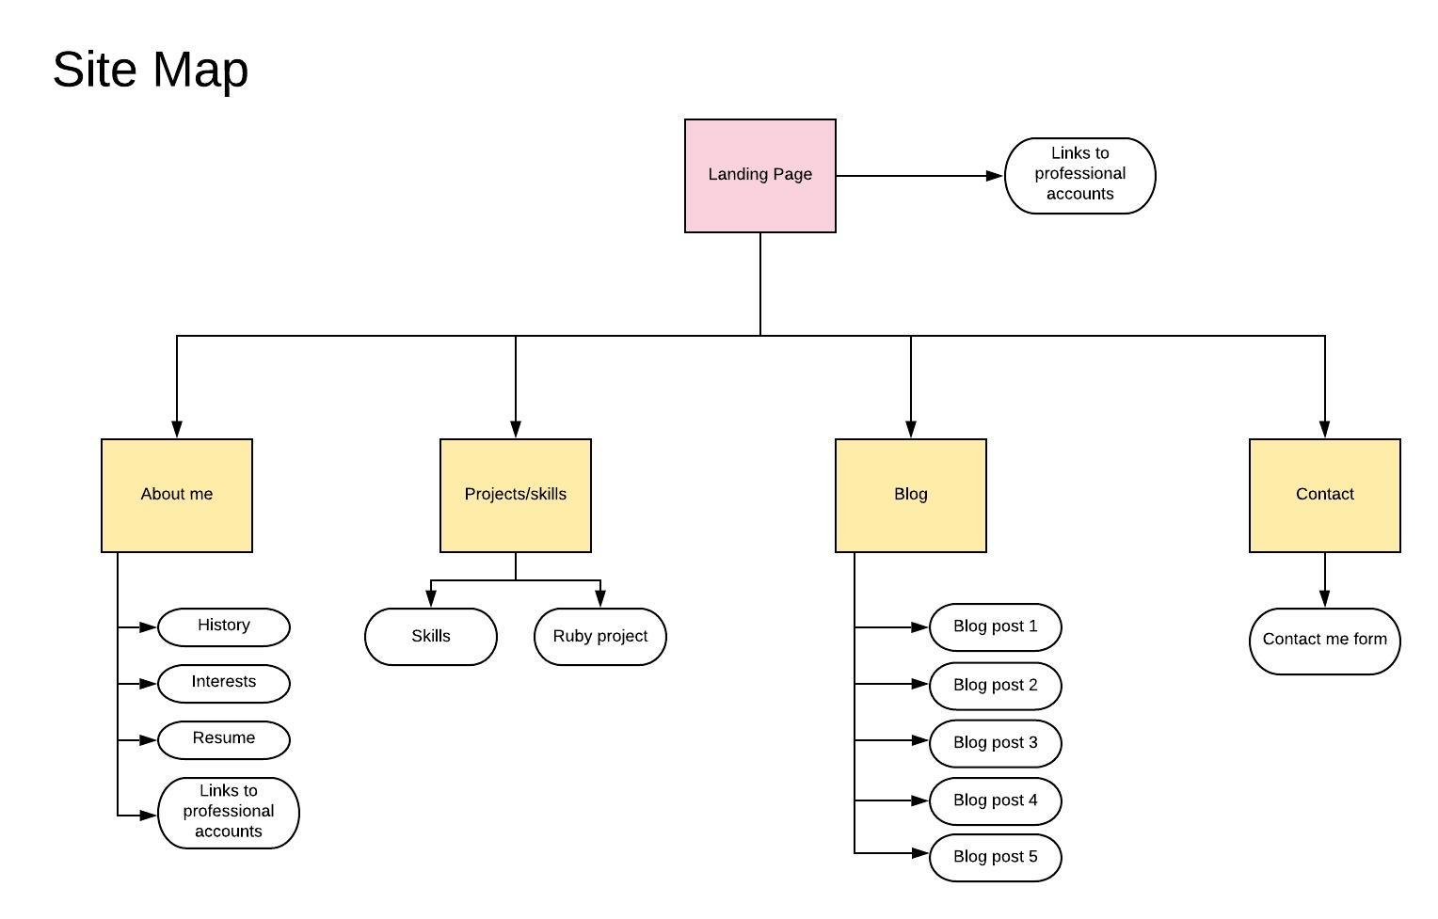
Sitemap
Home page links to all pages from the navigation bar
Can download resume by clicking on link
Can contact me via the contact page
All pages are linked via the navigation bar
Footer contains links to socials

Slide 3
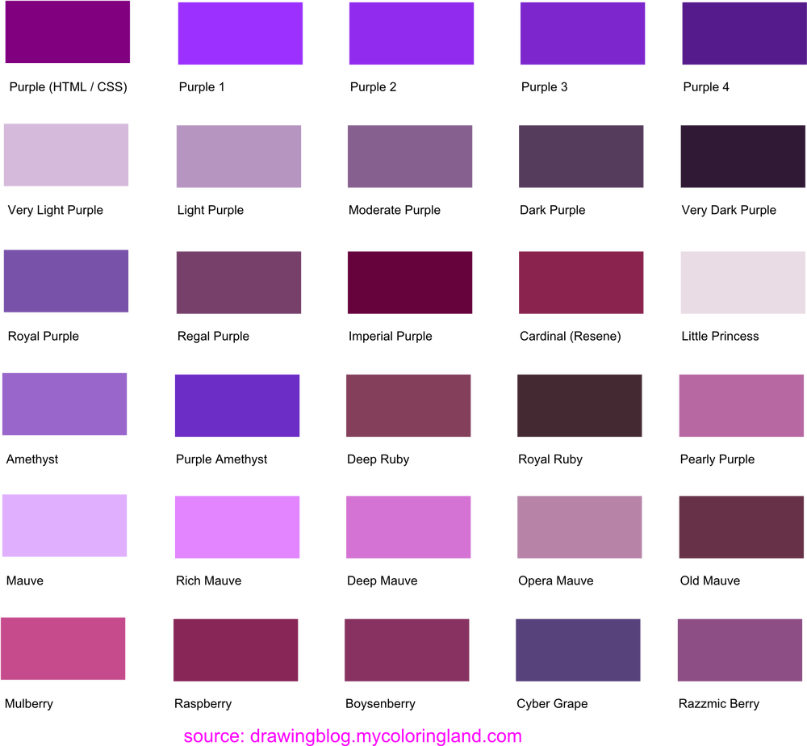


Style guide
Designed using shades of purple, grey and light yellow
Font style: sans-serif font, mainly Roboto and Raleway

Slide 4
List of components
My logo in top left corner on every page
Navigation bar in mobile view at the top right corner. Used fontawesome hamburger bars to indicate the navigation bar. When clicked on, the navigation menu drops down from the top of the screen.
Animation throughout most pages
A footer with a hyperlink to the top of the page to take the user to back to the top of the page
A section at the bottom of the page with fontawesome icons indicating my professional accounts - when clicked it opens up in a new tab
My resume on the About page - when clicked it will download my resume.
A contact form where the user can get in touch with me

Slide 5
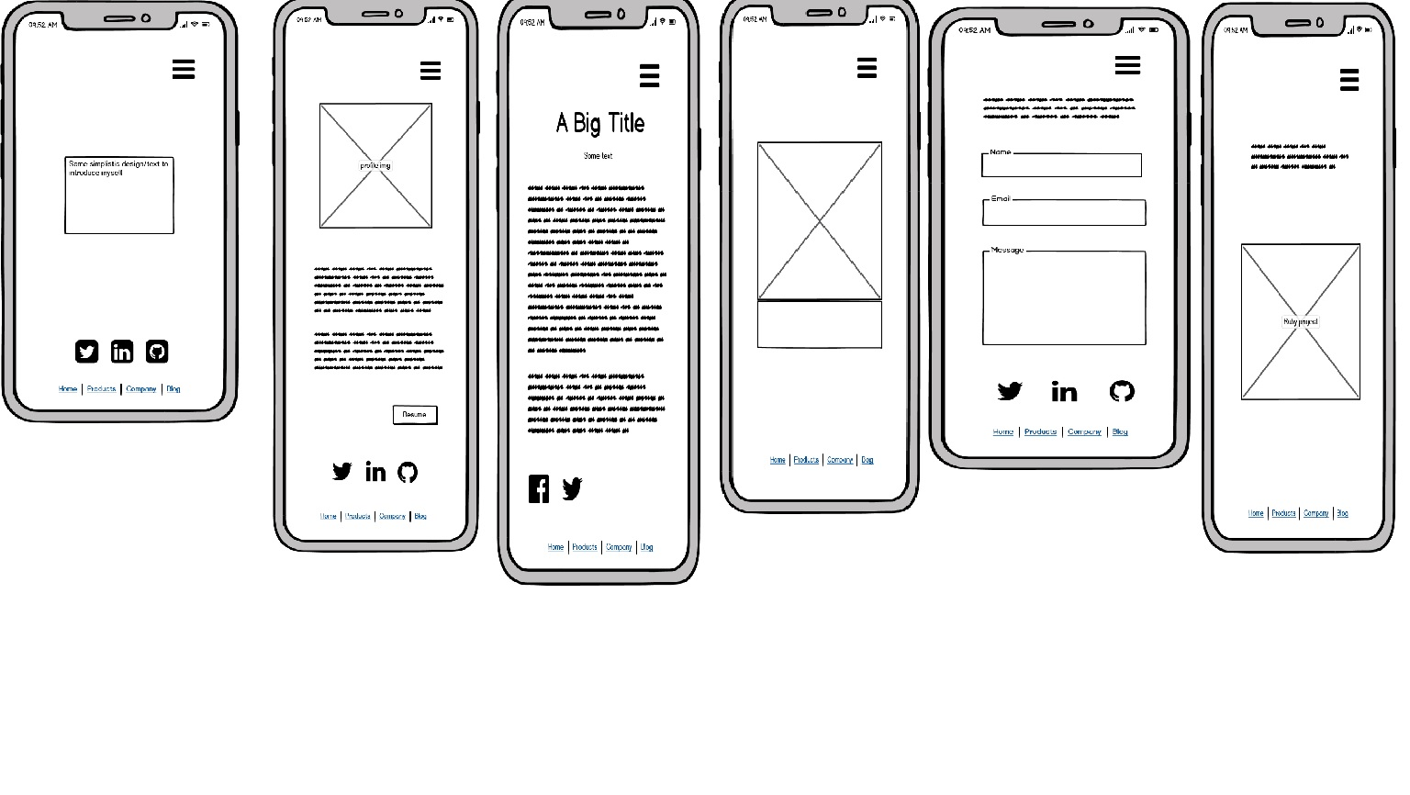
Mobile wireframes

Slide 6
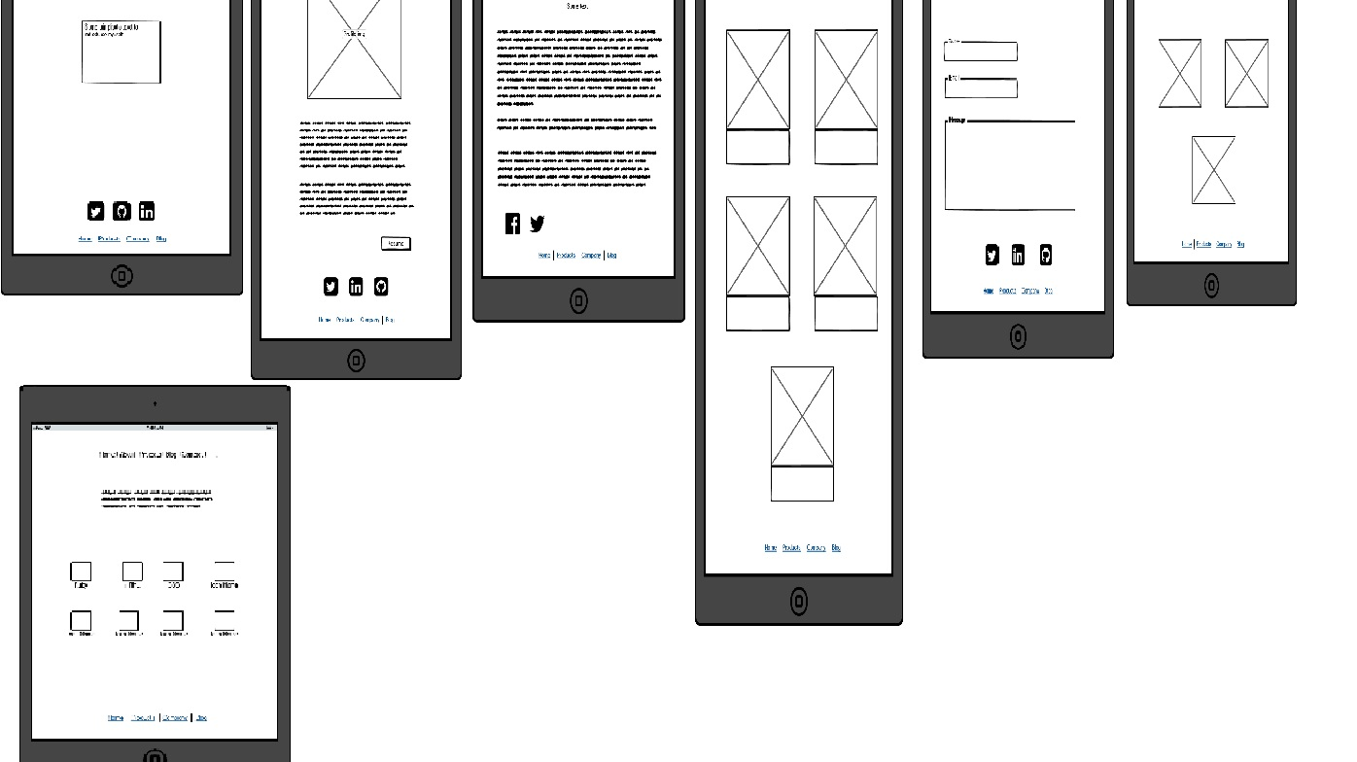
Tablet wireframes

Slide 7
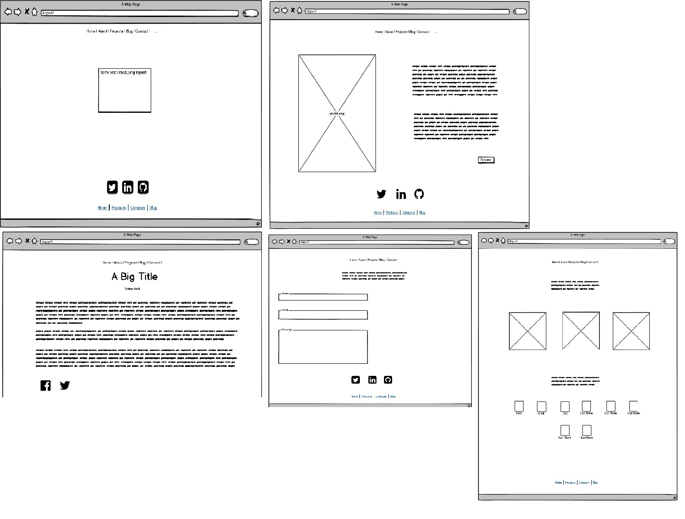
Desktop wireframes

Slide 8
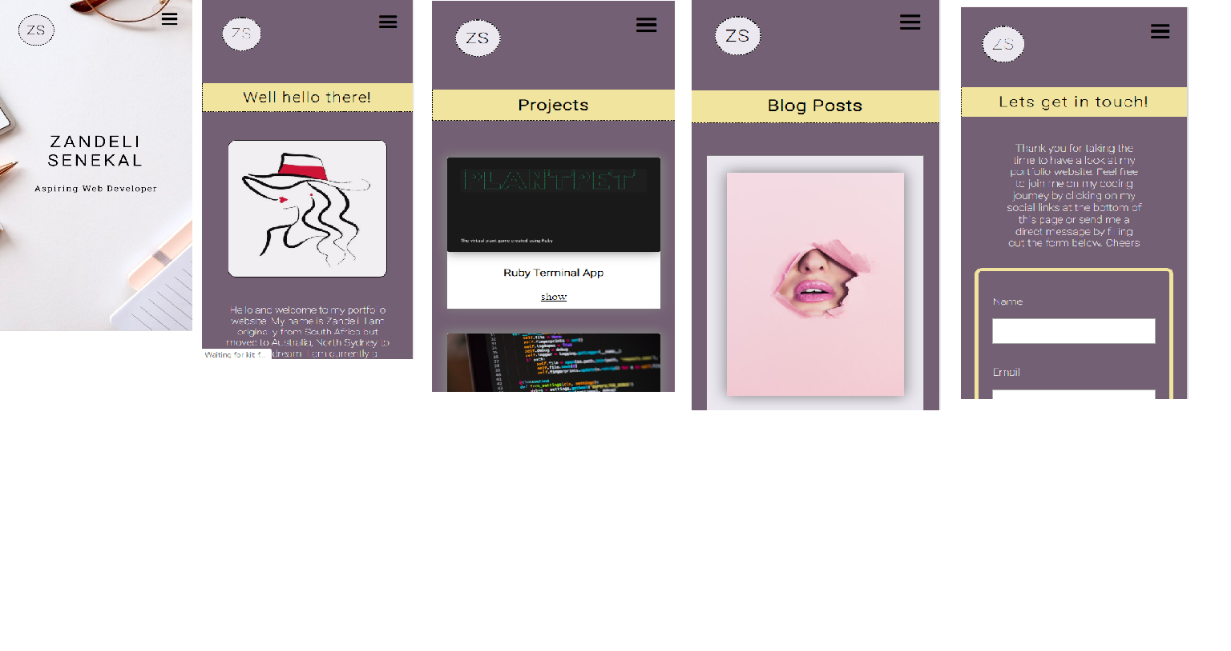
Mobile view

Slide 9

I hope you enjoy my website ☺

